Slide 1
CAS CS 460
Introduction to Database Systems
Functional Dependencies
and
Normal Forms
(Chapter 19)

Slide 2
Review: Database Design
Requirements Analysis
user needs; what must database do?
Conceptual Design
high level descr (often done w/ER model)
Logical Design
translate ER into DBMS data model
Schema Refinement
consistency, normalization
Physical Design - indexes, disk layout
Security Design - who accesses what

Slide 3
Keys (review)
A key is a set of attributes that uniquely identifies each tuple in a relation.
A candidate key is a key that is minimal.
If AB is a candidate key, then neither A nor B is a key on its own.
A superkey is a key that is not necessarily minimal (although it could be)
If AB is a candidate key then ABC, ABD, and even AB are superkeys.

Slide 4
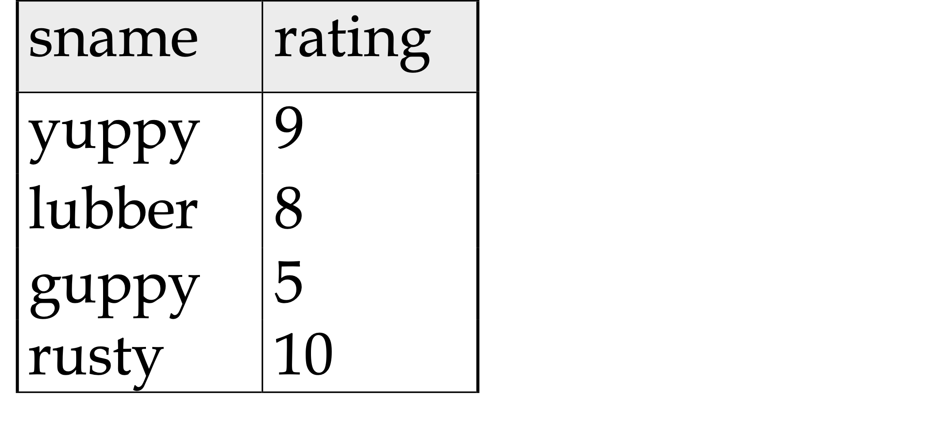
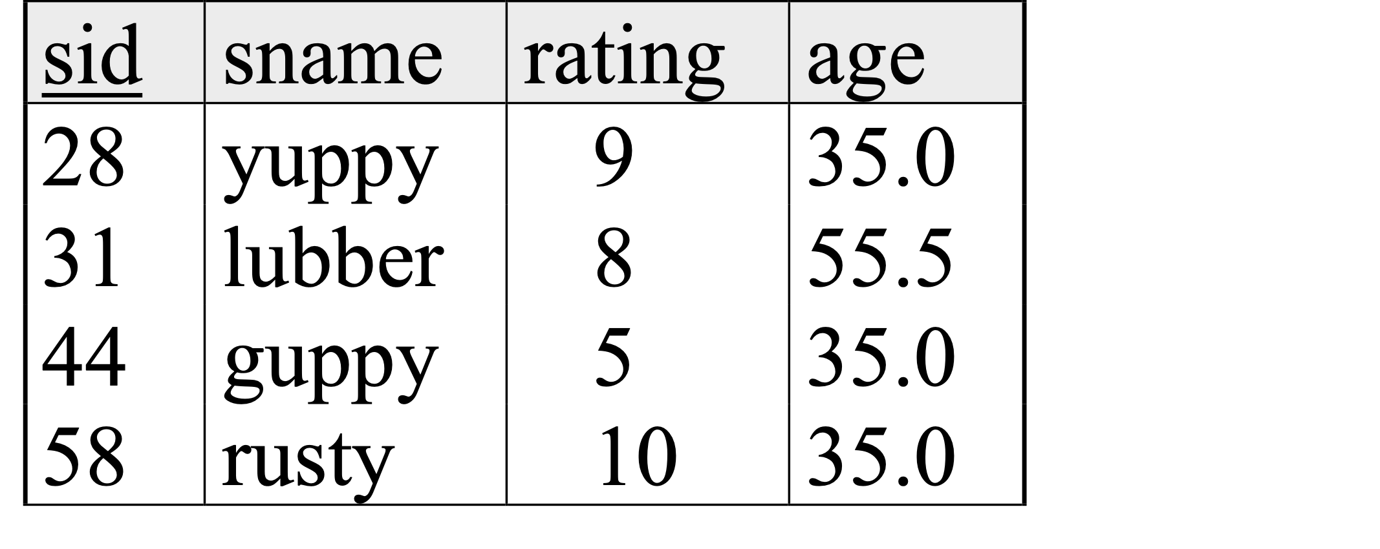
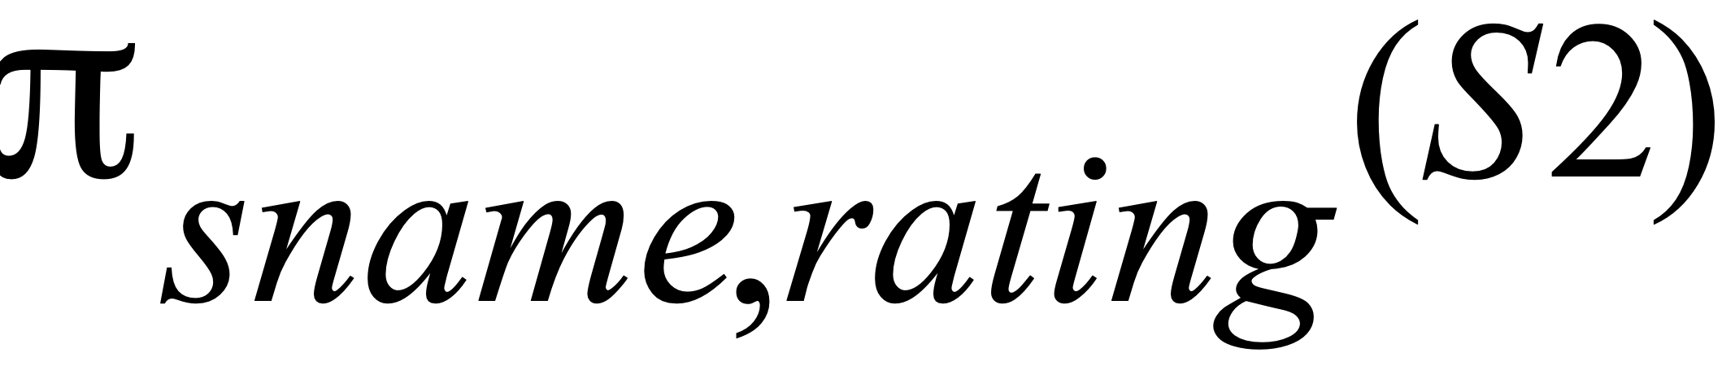
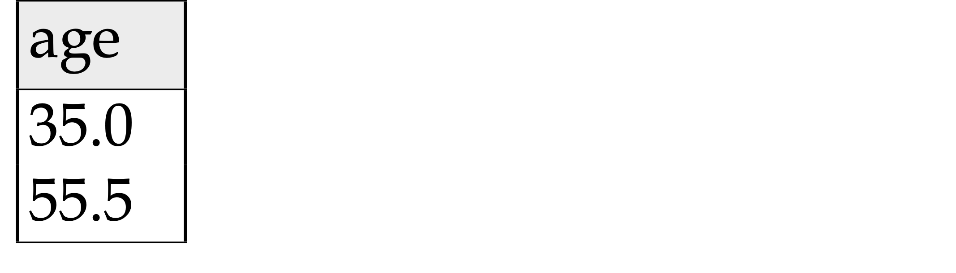
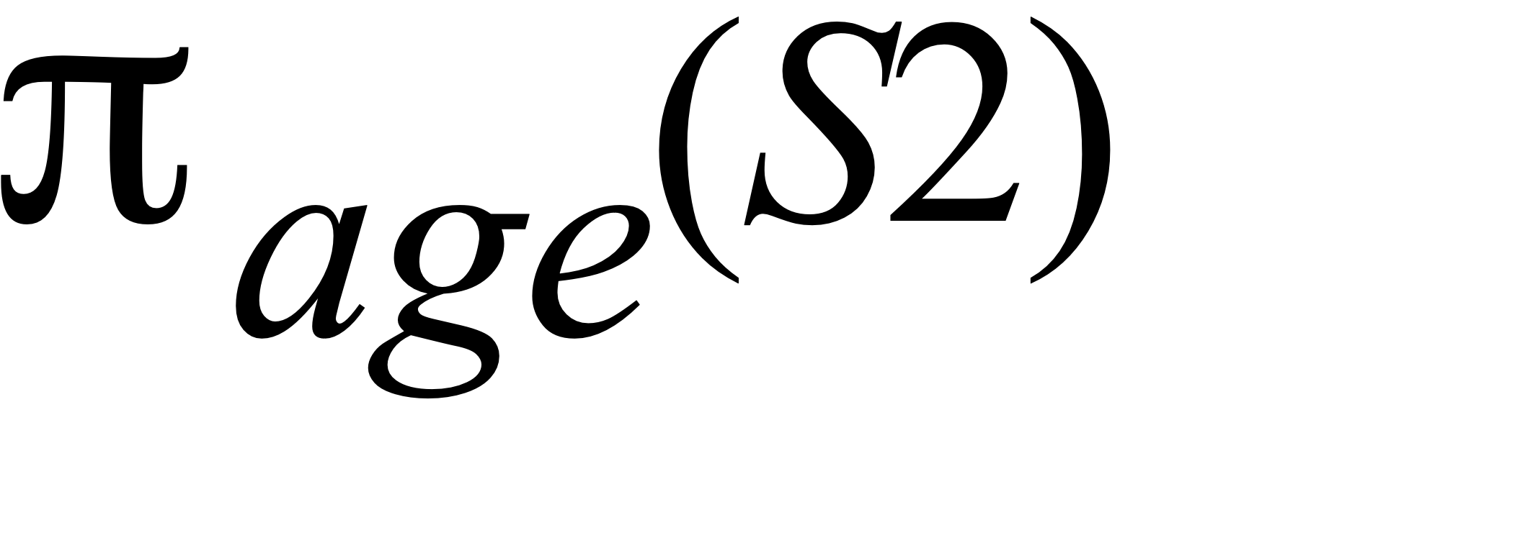
(Review) Projection
S2

Slide 5
Functional Dependencies (FDs)
A functional dependency X → Y holds over relation schema R if, for every allowable instance r of R:
t1 ∈ r, t2 ∈ r, π_{X} (t1) = π_{X} (t2)
implies π_{Y} (t1) = π_{Y} (t2)
(where t1 and t2 are tuples;X and Y are sets of attributes)
In other words: X → Y means
Given any two tuples in r, if the X values are the same, then the Y values must also be the same. (but not vice versa)
Can read “→” as “determines”

Slide 6
FD’s Continued
An FD is a statement about all allowable relations.
Identified based on application semantics
Given some instance r1 of R, we can check if r1 violates some FD f, but we cannot determine if f holds over R.
How related to keys?
if “K → all attributes of R” then
K is a superkey for R
(does not require K to be minimal.)
FDs are a generalization of keys.

Slide 7
Example: Constraints on Entity Set
Consider relation obtained from Hourly_Emps:
Hourly_Emps (ssn, name, lot, rating, wage_per_hr, hrs_per_wk)
We sometimes denote a relation schema by listing the attributes: e.g., SNLRWH
This is really the set of attributes {S,N,L,R,W,H}.
Sometimes, we refer to the set of all attributes of a relation by using the relation name. e.g., “Hourly_Emps” for SNLRWH
What are some FDs on Hourly_Emps (Given)?
ssn is the key: S → SNLRWH
rating determines wage_per_hr: R → W
lot determines lot: L → L (“trivial” dependnency)

Slide 8
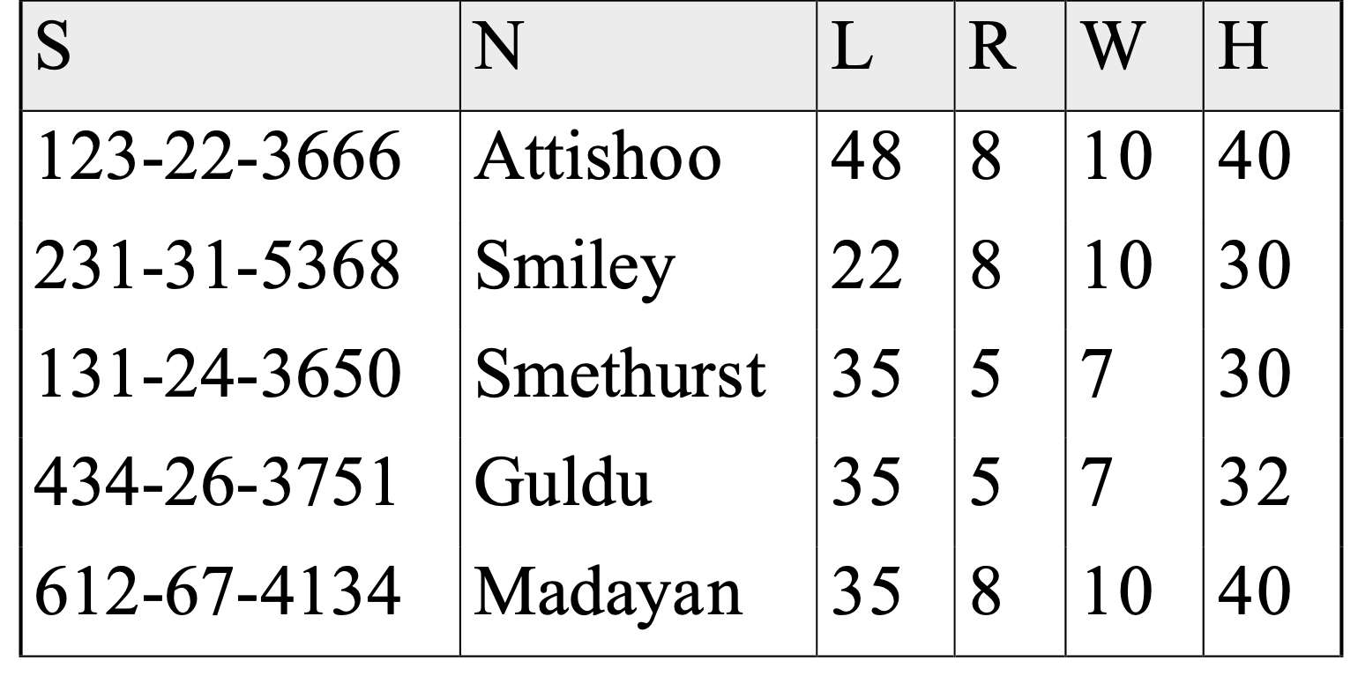
Redundancy Problems Due to R → W
Hourly_Emps
Update anomaly: Can we modify W in only the 1st tuple of SNLRWH?
Insertion anomaly: What if we want to insert an employee and don’t know the hourly wage for his or her rating? (or we get it wrong?)
Deletion anomaly: If we delete all employees with rating 5, we lose the information about the wage for rating 5!

Slide 9
Detecting Redundancy
Hourly_Emps
Q: Why is R → W problematic, but S →W not?

Slide 10
Taming Schema Redundancy
Integrity constraints, in particular functional dependencies, can be used to identify schemas with such problems and to suggest refinements.
Main refinement technique: decomposition
replacing ABCD with, say, AB and BCD, or ACD and ABD.
Decomposition should be used judiciously:
Is there reason to decompose a relation?
What problems (if any) does the decomposition cause?

Slide 11
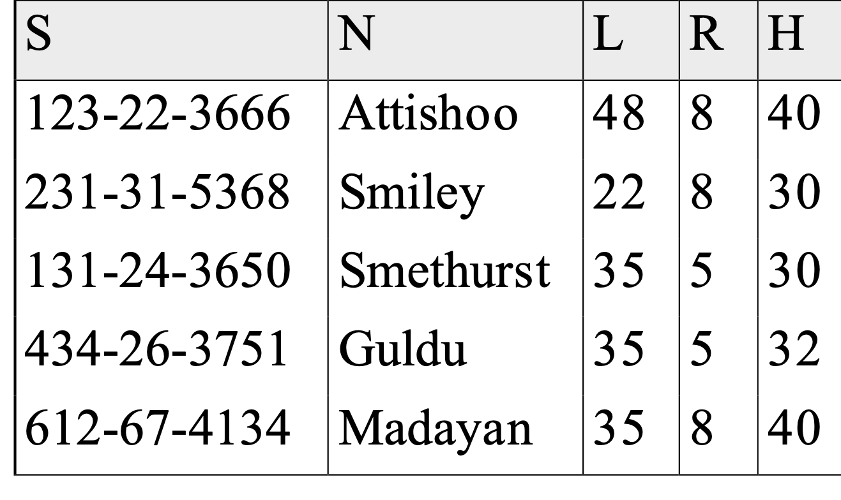
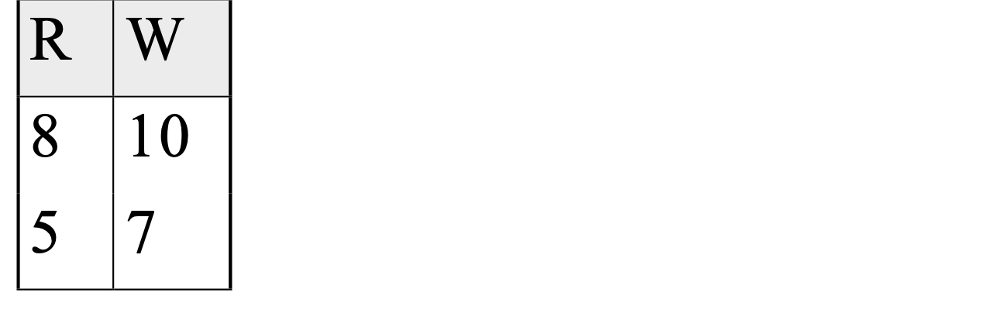
Decomposing a Relation
Redundancy can be removed by “chopping” the relation into pieces.
FD’s are used to drive this process.
R → W is causing the problems, so decompose SNLRWH into what relations?
Wages
Hourly_Emps2

Slide 12
Functional Dependencies (FDs)
A functional dependency X → Y holds over relation schema R if, for every allowable instance r of R:
t1 ∈ r, t2 ∈ r, π_{X} (t1) = π_{X} (t2)
implies π_{Y} (t1) = π_{Y} (t2)
(where t1 and t2 are tuples;X and Y are sets of attributes)
In other words: X → Y means
Given any two tuples in r, if the X values are the same, then the Y values must also be the same. (but not vice versa)
Can read “→” as “determines”

Slide 13
Reasoning About FDs
Given some FDs, we can usually infer additional FDs:
title → studio, star implies title → studio and title → star
title → studio and title → star implies title → studio, star
title → studio, studio → star implies title → star
But,
title, star → studio does NOT necessarily imply that
title → studio or that star → studio
An FD f is implied by a set of FDs F if f holds whenever all FDs in F hold.
F⁺ = closure of F is the set of all FDs that are implied by F. (includes “trivial dependencies”)

Slide 14
Rules of Inference
Armstrong’s Axioms (X, Y, Z are sets of attributes):
Reflexivity: If Y ⊇ X, then X → Y
Augmentation: If X → Y, then XZ → YZ for any Z
Transitivity: If X → Y and Y → Z, then X → Z
These are sound and complete inference rules for FDs!
i.e., using AA you can compute all the FDs in F+ and only these FDs.
Some additional rules (that follow from AA):
Union: If X → Y and X → Z, then X → YZ
Decomposition: If X → YZ, then X → Y and X → Z
Notes:
1 X->Z given
2 XX->XZ aug 1
3 X->XZ (sets of attributes)
4 X -> Y given
5 XZ -> YZ aug 4
6 X -> YZ trans 3,5

Slide 15
Example
Contracts(cid,sid,jid,did,pid,qty,value), and:
C is the key: C → CSJDPQV
Job purchases each part using single contract: JP → C
Dept purchases at most 1 part from a supplier: SD → P
Problem: Prove that SDJ is a key for Contracts
JP → C, C → CSJDPQV imply JP → CSJDPQV
(by transitivity) (shows that JP is a key)
SD → P implies SDJ → JP (by augmentation)
SDJ → JP, JP → CSJDPQV imply SDJ → CSJDPQV
(by transitivity) thus SDJ is a key.
Q: can you now infer that SD → CSDPQV (i.e., drop J on both sides)?
No! FD inference is not like arithmetic multiplication.

Slide 16
Attribute Closure
Size of F⁺ is exponential in # attributes in R;
Computing it can be expensive.
If we just want to check if a given FD X →Y is in F⁺, then:
1) Compute the attribute closure of X (denoted X⁺) wrt F
X⁺ = Set of all attributes A such that X → A is in F⁺
initialize X⁺ := X
Repeat until no change:
if U → V in F such that U is in X⁺, then add V to X⁺
2) Check if Y is in X⁺
Can also be used to find the keys of a relation.
If all attributes of R are in X⁺ then X is a superkey for R.
Q: How to check if X is a “candidate key”?

Slide 17
Attribute Closure (example)
R = {A, B, C, D, E}
F = { B →CD, D → E, B → A, E → C, AD →B }
Is B → E in F⁺ ?
B⁺ = B
B⁺ = BCD
B⁺ = BCDA
B⁺ = BCDAE … Yes! B is a key for R too!
Is D a key for R?
D⁺ = D
D⁺ = DE
D⁺ = DEC
… Nope!
Is AD a key for R? AD⁺ = AD
AD⁺ = ABD and B is a key, so Yes!
Is AD a candidate key for R?
A⁺ = A
A not a key, nor is D so Yes!
Is ADE a candidate key for R?
No! AD is a key, so ADE is a superkey, but not a cand. key

Slide 18
Normal Forms
Question: is any refinement needed??!
If a relation is in a normal form (BCNF, 3NF etc.):
we know that certain problems are avoided/minimized.
helps decide whether decomposing a relation is useful.
NFs are syntactic rules (don’t need to understand app)
Role of FDs in detecting redundancy:
Consider a relation R with 3 attributes, ABC.
No (non-trivial) FDs hold: There is no redundancy here.
Given A → B: If A is not a key, then several tuples could have the same A value, and if so, they’ll all have the same B value!
1st Normal Form – all attributes are atomic (i.e., “flat tables”)
1st ⊃2nd (of historical interest) ⊃ 3rd ⊃ Boyce-Codd ⊃ …

Slide 19
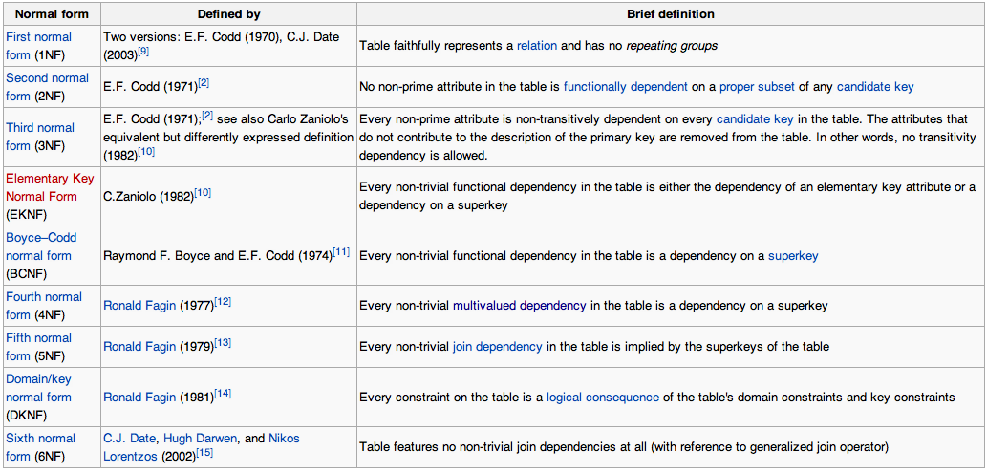
Normal Forms

Slide 20
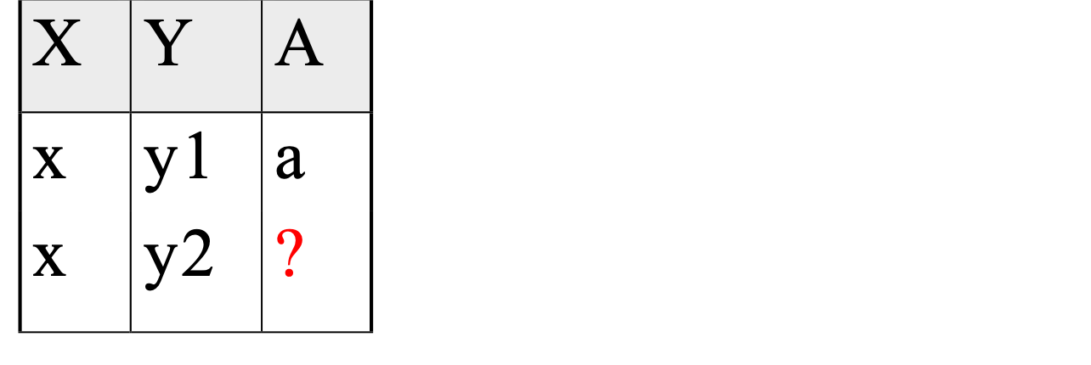
Boyce-Codd Normal Form (BCNF)
Reln R with FDs F is in BCNF if, for all X → A in F⁺
A ∈ X (called a trivial FD), or
X is a superkey for R.
In other words: “R is in BCNF if the only non-trivial FDs over R are key constraints.”
If R in BCNF, then every field of every tuple records information that cannot be inferred using FDs alone.
Say we are told that FD X → A holds for this example relation:
Can you guess the value of the missing attribute?
Yes, so relation is not in BCNF

Slide 21
Boyce-Codd Normal Form - Alternative Formulation
“The key, the whole key, and nothing but the key”

Slide 22
Decomposition of a Relation Scheme
If a relation is not in a desired normal form, it can be decomposed into multiple relations that each are in that normal form.
Suppose that relation R contains attributes A1 ... An. A decomposition of R consists of replacing R by two or more relations such that:
Each new relation scheme contains a subset of the attributes of R, and
Every attribute of R appears as an attribute of at least one of the new relations.

Slide 23
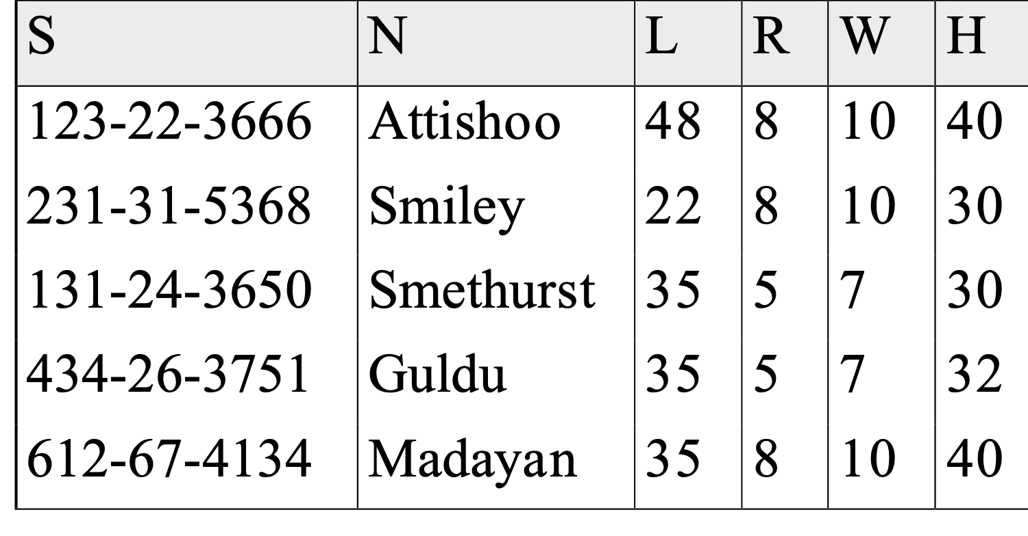
Example
Hourly_Emps
SNLRWH has FDs S → SNLRWH and R → W
Q: Is this relation in BCNF?
No, The second FD causes a violation; W values repeatedly associated with R values.

Slide 24
Decomposing a Relation
Easiest fix is to create a relation RW to store these associations, and to remove W from the main schema:
Wages
Hourly_Emps2
Q: Are both of these relations now in BCNF?
Decompositions should be used only when needed.
Q: potential problems of decomposition?

Slide 25
Refining an ER Diagram
1st diagram becomes: Workers(S,N,L,D,Si) Departments(D,M,B)
Lots associated with workers.
Suppose all workers in a dept are assigned the same lot:
D → L
Redundancy; fixed by: Workers2(S,N,D,Si) Dept_Lots(D,L) Departments(D,M,B)
Can fine-tune this: Workers2(S,N,D,Si) Departments(D,M,B,L)
Before:
since
name
dname
ssn
lot
did
budget
Employees
Works_In
Departments
After:
budget
since
name
dname
ssn
did
lot
Employees
Works_In
Departments

Slide 26
Decomposing a Relation
Easiest fix is to create a relation RW to store these associations, and to remove W from the main schema:
Wages
Hourly_Emps2
Q: Are both of these relations now in BCNF?
Decompositions should be used only when needed.
Q: potential problems of decomposition?

Slide 27
Problems with Decompositions
There are three potential problems to consider:
1) May be impossible to reconstruct the original relation! (Lossiness)
Fortunately, not in the SNLRWH example.
2) Dependency checking may require joins.
Fortunately, not in the SNLRWH example.
3) Some queries become more expensive.
e.g., How much does Guldu earn?
Lossiness (#1) cannot be allowed
#2 and #3 are design tradeoffs: Must consider these issues vs. redundancy.

Slide 28
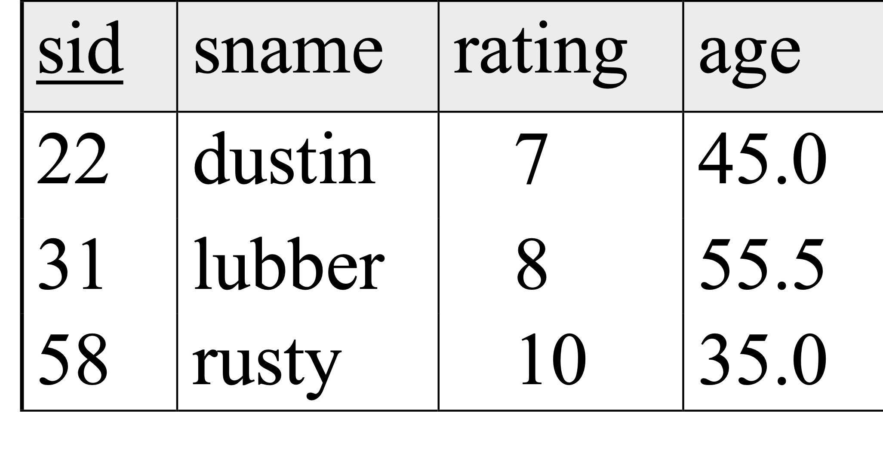
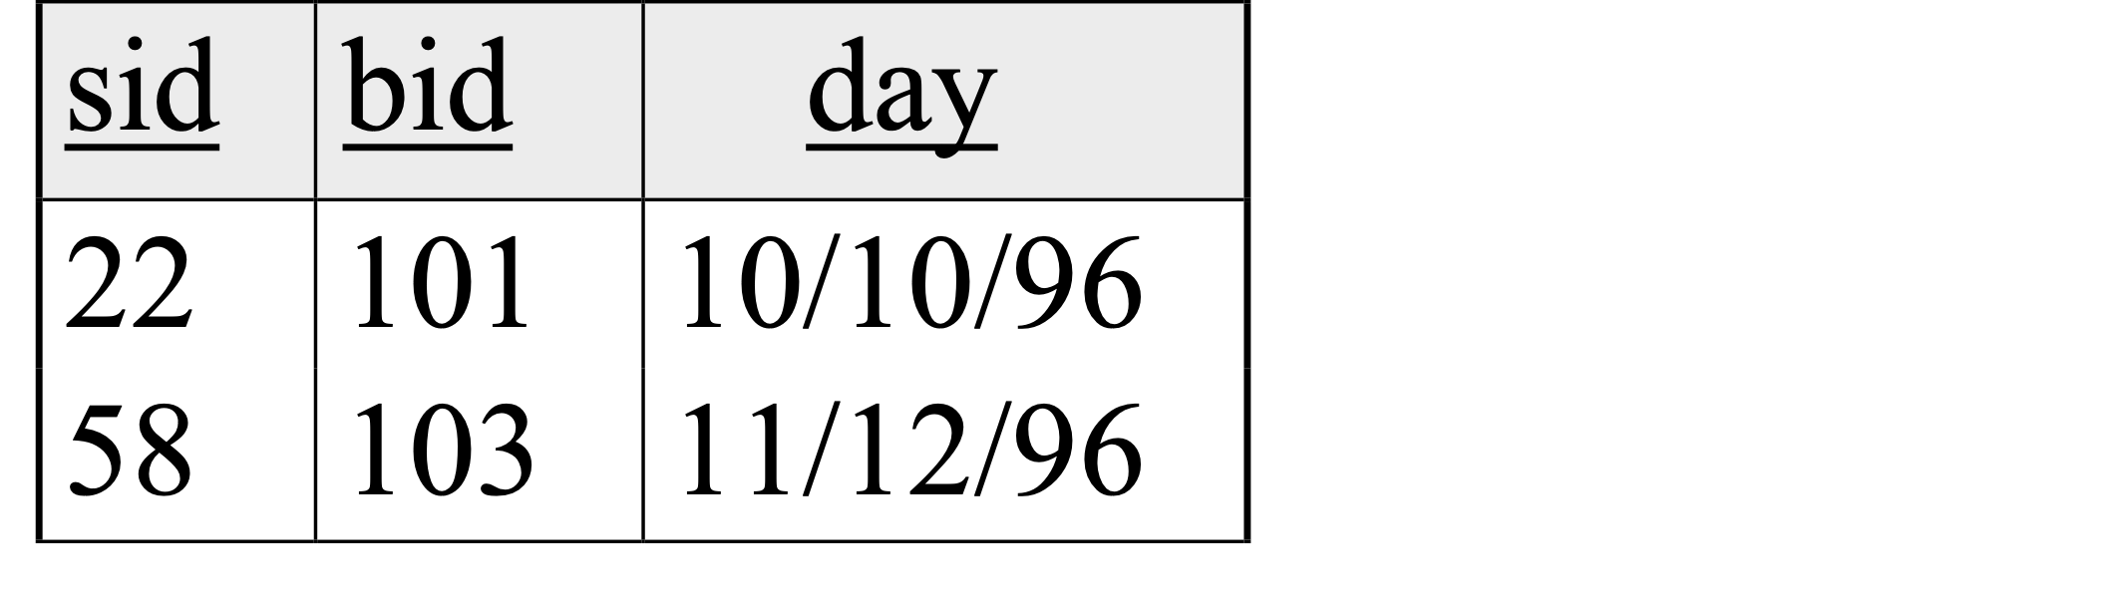
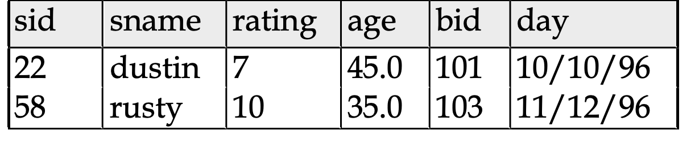
Natural Join Example
R1
S1
R1 S1 =

Slide 29
Lossless Decomposition (example)
=

Slide 30
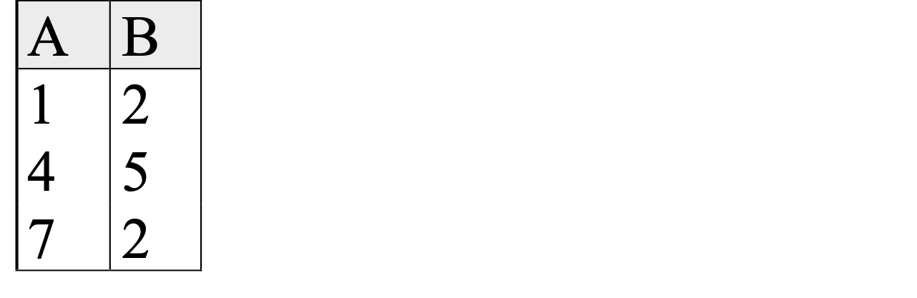

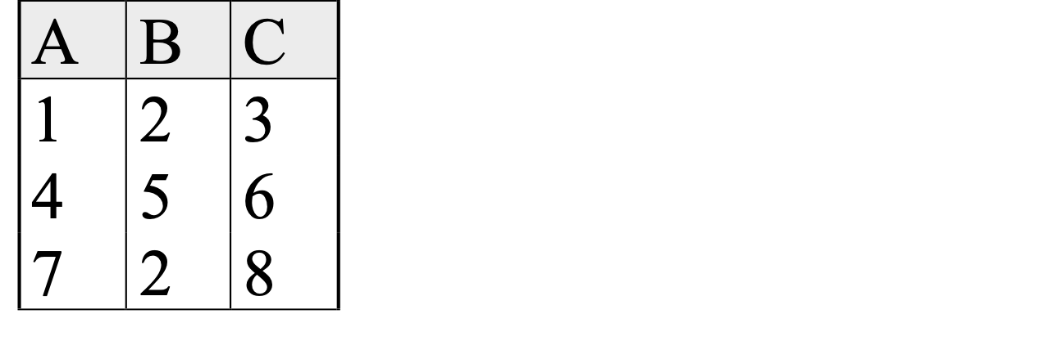
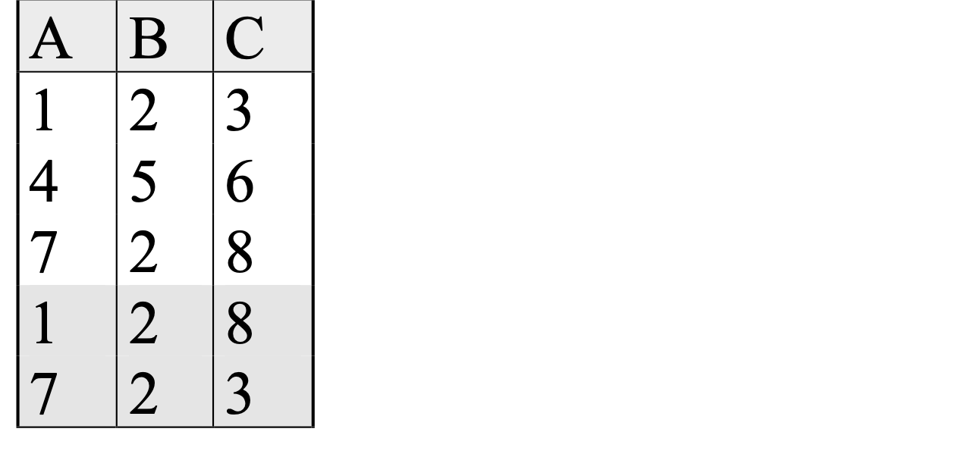
Lossy Decomposition (example)
A → B; C → B
=

Slide 31


Lossless Decomposition
Decomposition of R into X and Y is lossless-join w.r.t. a set of FDs F if, for every instance r that satisfies F:
(r) (r) = r
The decomposition of R into X and Y is lossless with respect to F if and only if F⁺ contains:
X ∩ Y → X, or
X ∩ Y → Y
in previous example: decomposing ABC into AB and BC is lossy, because intersection (i.e., “B”) is not a key of either resulting relation.
Useful result: If W → Z holds over R and W ∩ Z is empty, then decomposition of R into R-Z and WZ is lossless.

Slide 32

Lossless Decomposition (example)
A → B; C → B
=
But, now we can’t check A → B without doing a join!

Slide 33
Dependency Preserving Decomposition
Dependency preserving decomposition (Intuitive):
If R is decomposed into X, Y and Z, and we enforce the FDs that hold individually on X, on Y and on Z, then all FDs that were given to hold on R must also hold. (Avoids Problem #2 on our list.)
The projection of F on attribute set X (denoted F_{X} ) is the set of FDs
U → V in F⁺ (closure of F , not just F ) such that all of the attributes on both sides of the f.d. are in X.
That is: U and V are subsets of X

Slide 34
Dependency Preserving Decompositions (Contd.)
Decomposition of R into X and Y is dependency preserving if
(F_{X} ∪ F_{Y} ) ⁺ = F ⁺
i.e., if we consider only dependencies in the closure F ⁺ that can be checked in X without considering Y, and in Y without considering X, these imply all dependencies in F ⁺.
Important to consider F ⁺ in this definition:
ABC, A → B, B → C, C → A, decomposed into AB and BC.
Is this dependency preserving? Is C → A preserved?????
note: F ⁺ contains F ∪ {A → C, B → A, C → B}, so…
F_{AB} contains A →B and B → A; F_{BC} contains B → C and C → B
So, (F_{AB} ∪ F_{BC})⁺ contains C → A

Slide 35
Boyce-Codd Normal Form (BCNF)
Reln R with FDs F is in BCNF if, for all X → A in F⁺
A ∈ X (called a trivial FD), or
X is a superkey for R.
In other words: “R is in BCNF if the only non-trivial FDs over R are key constraints.”

Slide 36
Decomposition into BCNF
Consider relation R with FDs F.
If X → Y violates BCNF, decompose R into R - Y and XY
(guaranteed to be lossless).
Repeated application of this idea will give us a collection of relations that are in BCNF; lossless join decomposition, and guaranteed to terminate.
e.g., CSJDPQV, key C, JP → C, SD → P, J → S
{contractid, supplierid, projectid,deptid,partid, qty, value}
To deal with SD → P, decompose into SDP, CSJDQV.
To deal with J → S, decompose CSJDQV into JS and CJDQV
So we end up with: SDP, JS, and CJDQV
Note: several dependencies may cause violation of BCNF. The order in which we fix them could lead to very different sets of relations!

Slide 37
BCNF and Dependency Preservation
In general, there may not be a dependency preserving decomposition into BCNF.
e.g., CSZ, CS → Z, Z → C
Can’t decompose while preserving 1st FD; not in BCNF.
Similarly, decomposition of CSJDPQV into SDP, JS and CJDQV is not dependency preserving (w.r.t. the FDs JP → C, SD → P and J → S).
{contractid, supplierid, projectid,deptid,partid, qty, value}
However, it is a lossless join decomposition.
In this case, adding JPC to the collection of relations gives us a dependency preserving decomposition.
but JPC tuples are stored only for checking the f.d. (Redundancy!)

Slide 38
Third Normal Form (3NF)
Reln R with FDs F is in 3NF if, for all X → A in F⁺
A ∈ X (called a trivial FD), or
X is a superkey of R, or
A is part of some candidate key (not superkey!) for R. (sometimes stated as “A is prime”)
Minimality of a key is crucial in third condition above!
If R is in BCNF, obviously in 3NF.
If R is in 3NF, some redundancy is possible. It is a compromise, used when BCNF not achievable (e.g., no ``good’’ decomp, or performance considerations).
Lossless-join, dependency-preserving decomposition of R into a collection of 3NF relations always possible.

Slide 39
Decomposition into 3NF
Obviously, the algorithm for lossless join decomp into BCNF can be used to obtain a lossless join decomp into 3NF (typically, can stop earlier) but does not ensure dependency preservation.
To ensure dependency preservation, one idea:
If X → Y is not preserved, add relation XY.
Problem is that XY may violate 3NF! e.g., consider the addition of CJP to `preserve’ JP → C. What if we also have J → C ?
Refinement: Instead of the given set of FDs F, use a minimal cover for F.

Slide 40
Minimal Cover for a Set of FDs
Minimal cover G for a set of FDs F:
Closure of F = closure of G.
Right hand side of each FD in G is a single attribute.
If we modify G by deleting an FD or by deleting attributes from an FD in G, the closure changes.
Intuitively, every FD in G is needed, and ``as small as possible’’ in order to get the same closure as F.
e.g., A → B, ABCD → E, EF → GH, ACDF → EG has the following minimal cover:
A → B, ACD → E, EF → G and EF → H
M.C. implies 3NF, Lossless-Join, Dep. Pres. Decomp!!!
(more in book)

Slide 41
Assertions
How to test if and FD is satisfied?
ASSERTIONS:
CREATE ASSERTION assertion_name CHECK predicate
Example:
CREATE ASSERTION SmallClub
CHECK ((SELECT COUNT(S.sid) FROM Sailors S) +
(SELECT COUNT(B.bid) FROM Boats B) < 100)

Slide 42
Another example
Assume that you have two relations, Trips and Accounts. Trips stores information about our Trips and Accounts store our accounts.
Constraint: We can have a Trip only if there is money in the accounts.
CREATE ASSERTION Trip_Account_Check
CHECK (NOT EXISTS (SELECT * FROM Trips) OR
EXISTS (SELECT * FROM Accounts WHERE balance > 0));

Slide 43
Assertions
Constraint: A customer with a loan should have an account with at least 1000 dollars.
create assertion balance_constraint check
(not exists (select * from loan L
where exists (select *
from borrower B, depositor D, account A
where L.loan_no = B.loan_no
and B.cname = D.cname and D.account_no = A.account_no
and A.balance < 1000 ))

Slide 44
Another example
customer(customer_name, customer_street, customer_city)
Constraint: Customer city is always not null.
Can enforce it with an assertion:
Create Assertion CityCheck Check
( NOT EXISTS (
Select *
From customer
Where customer_city is null));

